Slide 1
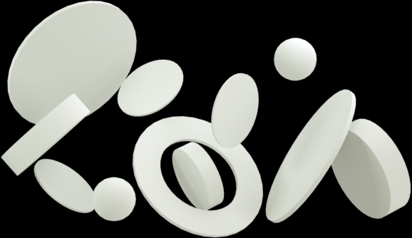





Exploratory Data Analysis of Cereals Dataset
Presented by Jeet Banik

Slide 2

jeetbanik.wixsite.com/cproject
Please visit this website for the detailed analysis report.

Slide 3
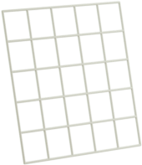
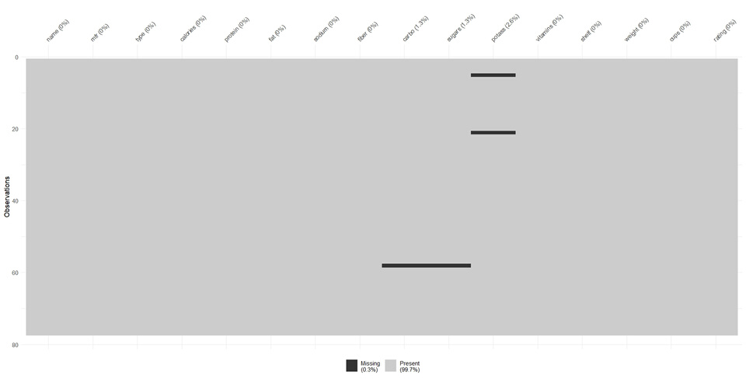
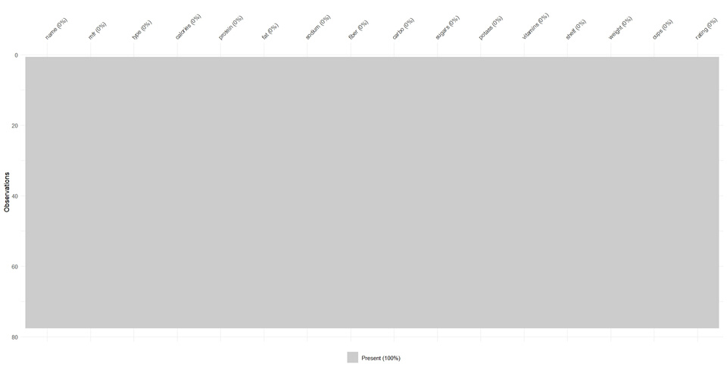
About Cereals Dataset
The dataset contains 16 variables of 77 distinct cereals,
mainly their names, manufacturers, calories, nutrients, and ratings.
It was observed by visualizing that there were 4 missing values in total.
KNN (K-Nearest Neighbors) method was used to impute these missing values. The same visualization is done again in order to confirm there are no more missing values in the data. Both of the visualizations are shown below respectively.

Slide 4


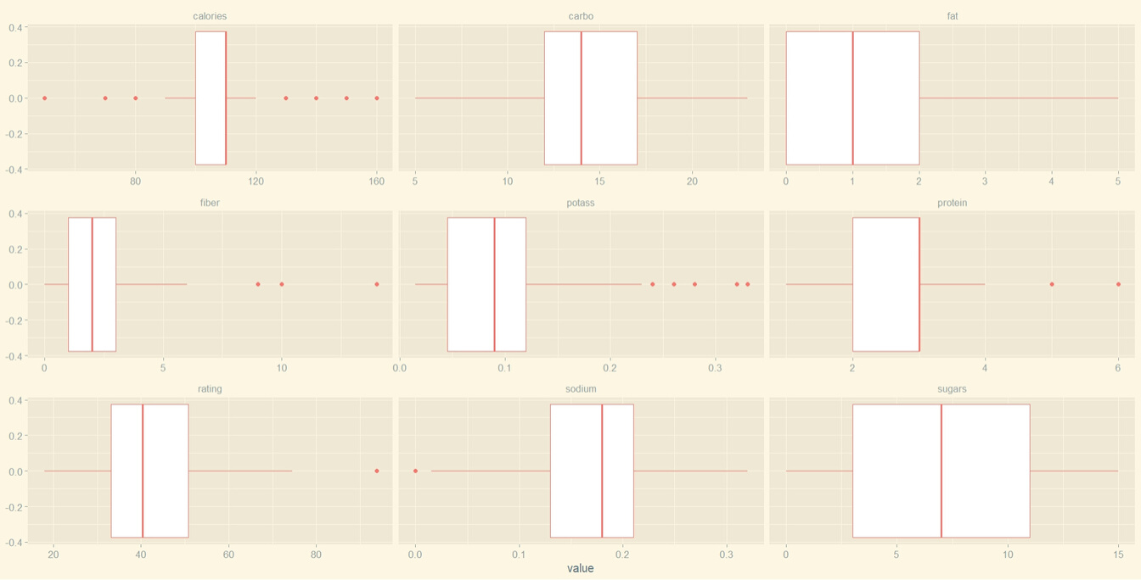
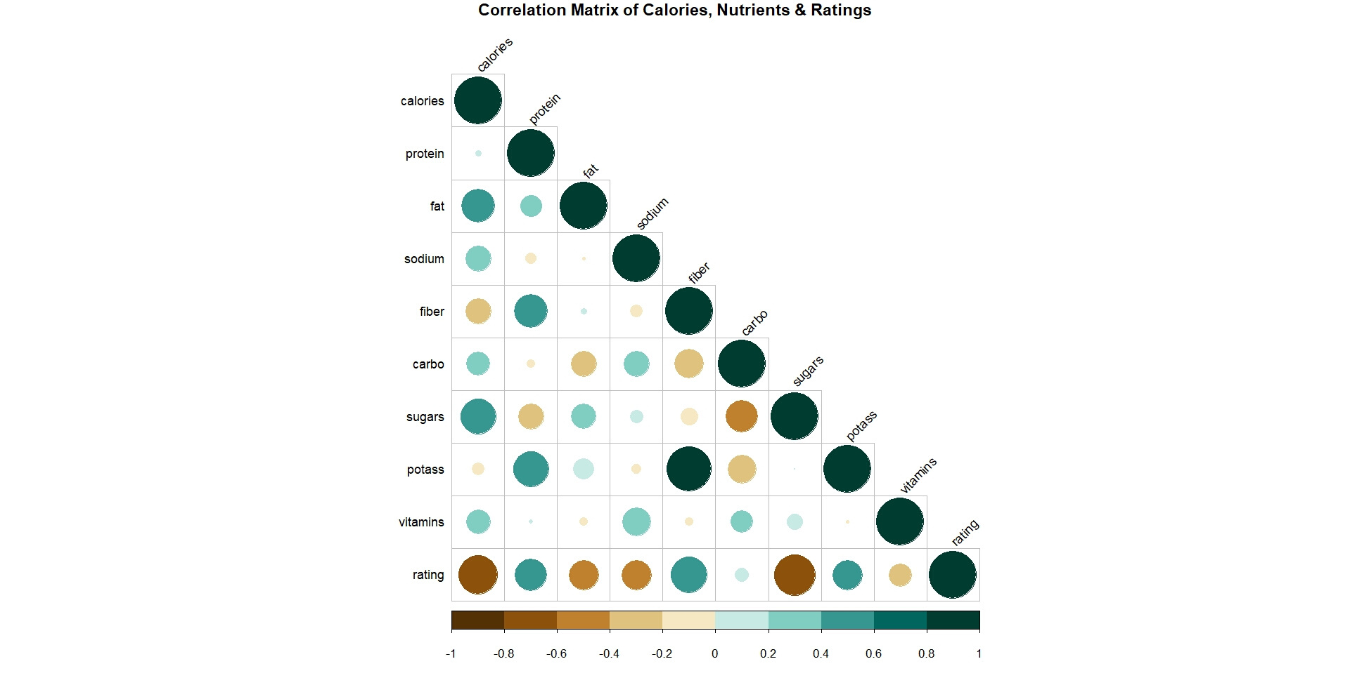
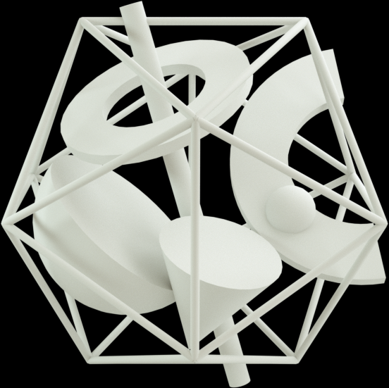
Visualization of Calories, Nutrients, and Ratings.
​It was done by plotting their individual box plots all together above.
Then, in order to check the relation among them, a correlation matrix of them was plotted in the right. We see that calories and ratings are negatively correlated, i.e., they have no relation between them.
We also see that calories and certain/most nutrients are positively correlated, especially calories has high correlation with fat and sugars. Nutrients and ratings are both positively and negatively correlated.

Slide 5

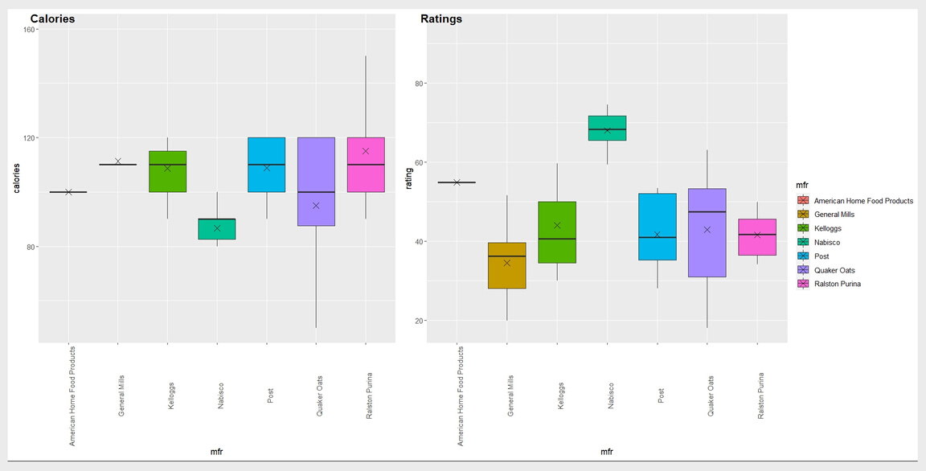
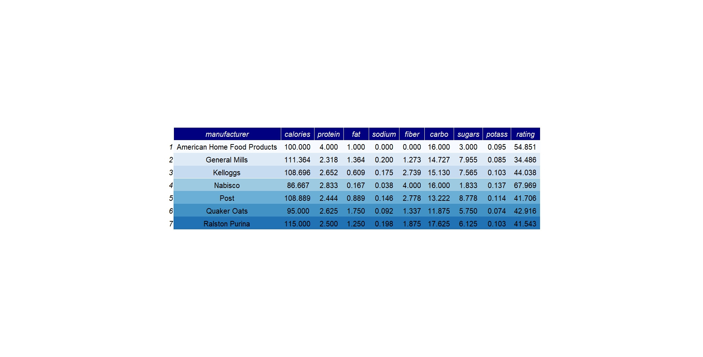
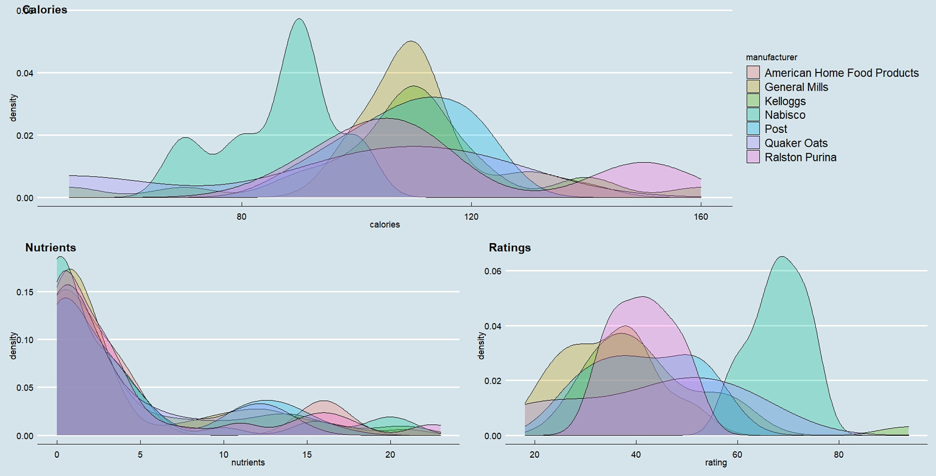
Few More Visualizations
Now, to see the comparison among calories, nutrients, and ratings, across different manufacturers, a table of their aggregate means for each manufacturer is plotted first in
the top left. To further understand this distribution, box plots of calories and ratings against manufacturers are plotted respectively next in the top right. Finally, density plots of
calories, nutrients and ratings
across different manufacturers are plotted respectively in the bottom.

Slide 6

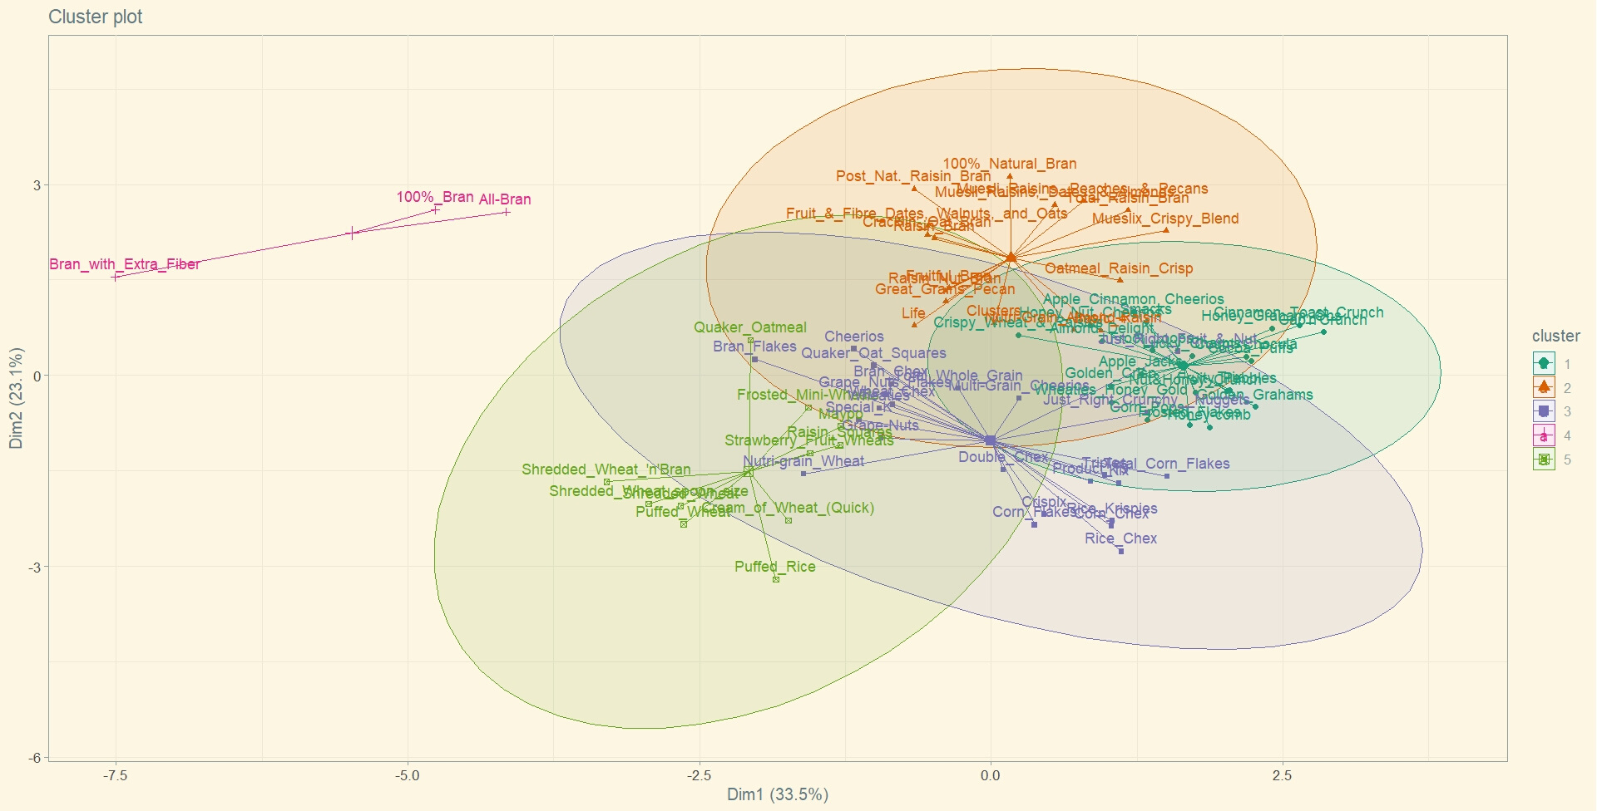
CLUSTERING OF CEREALS

Slide 7


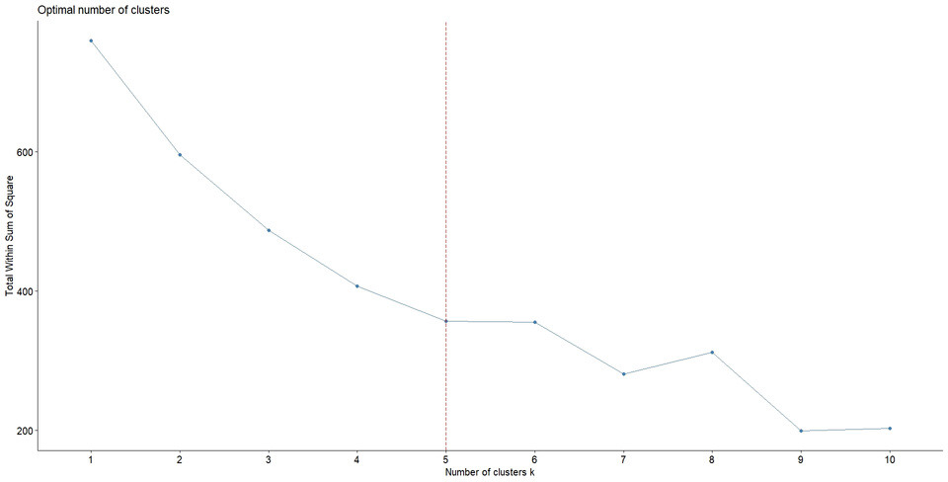
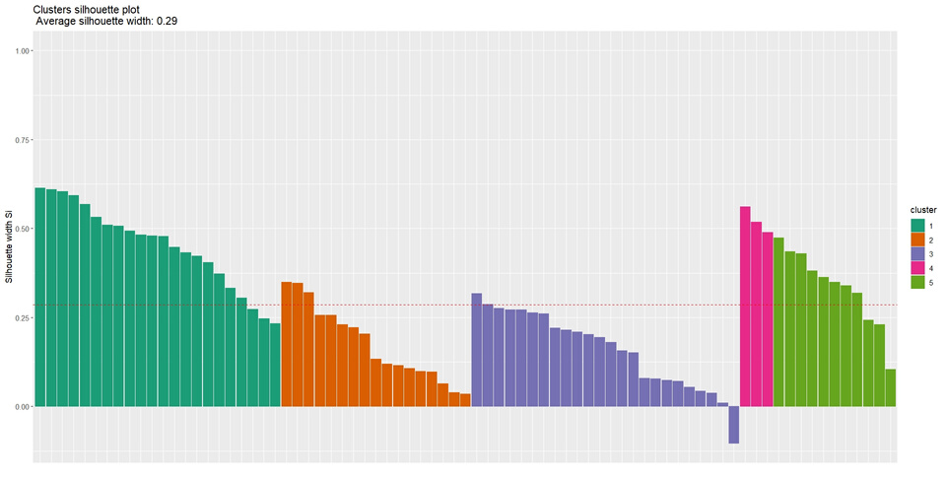
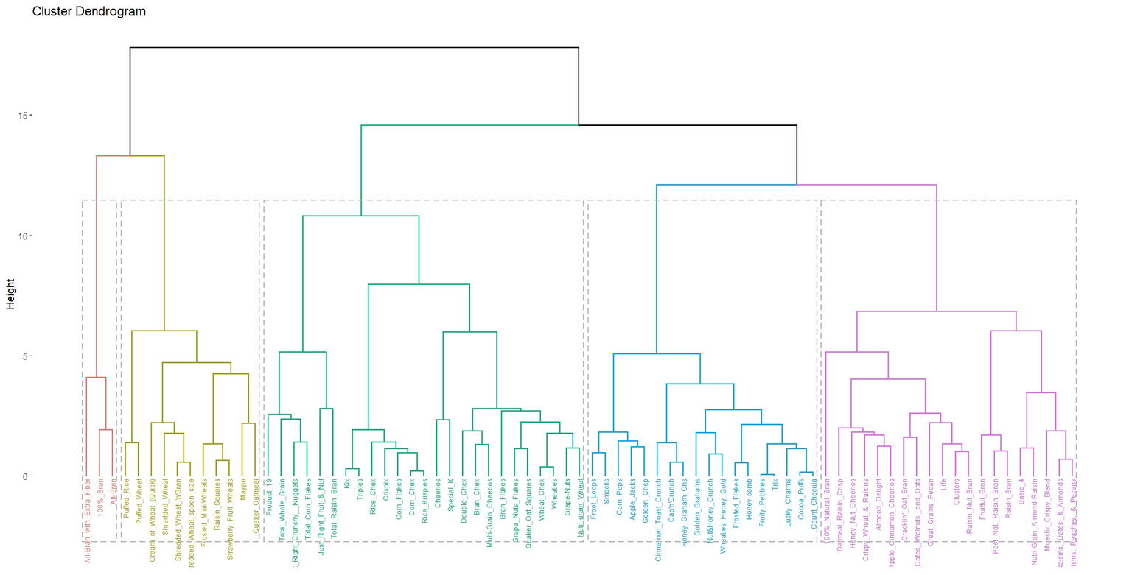
Cluster Analysis
Firstly, the quantitative data was scaled. The optimal number of clusters was found out to be 5 by the Elbow method as shown in the left. Then, clusters silhouette plot is shown in the right side in order to check if the clustering was correctly done. There seems to be only 1 out of 77 cereals wrongly allotted in all of the 5 clusters, so that's acceptable.
Finally, hierarchical clustering was done for the cereals data by first calculating the distance of the data variables among each other using euclidean method and then plotting a dendogram
by using the
Ward method
as shown in the
left side.

Slide 8

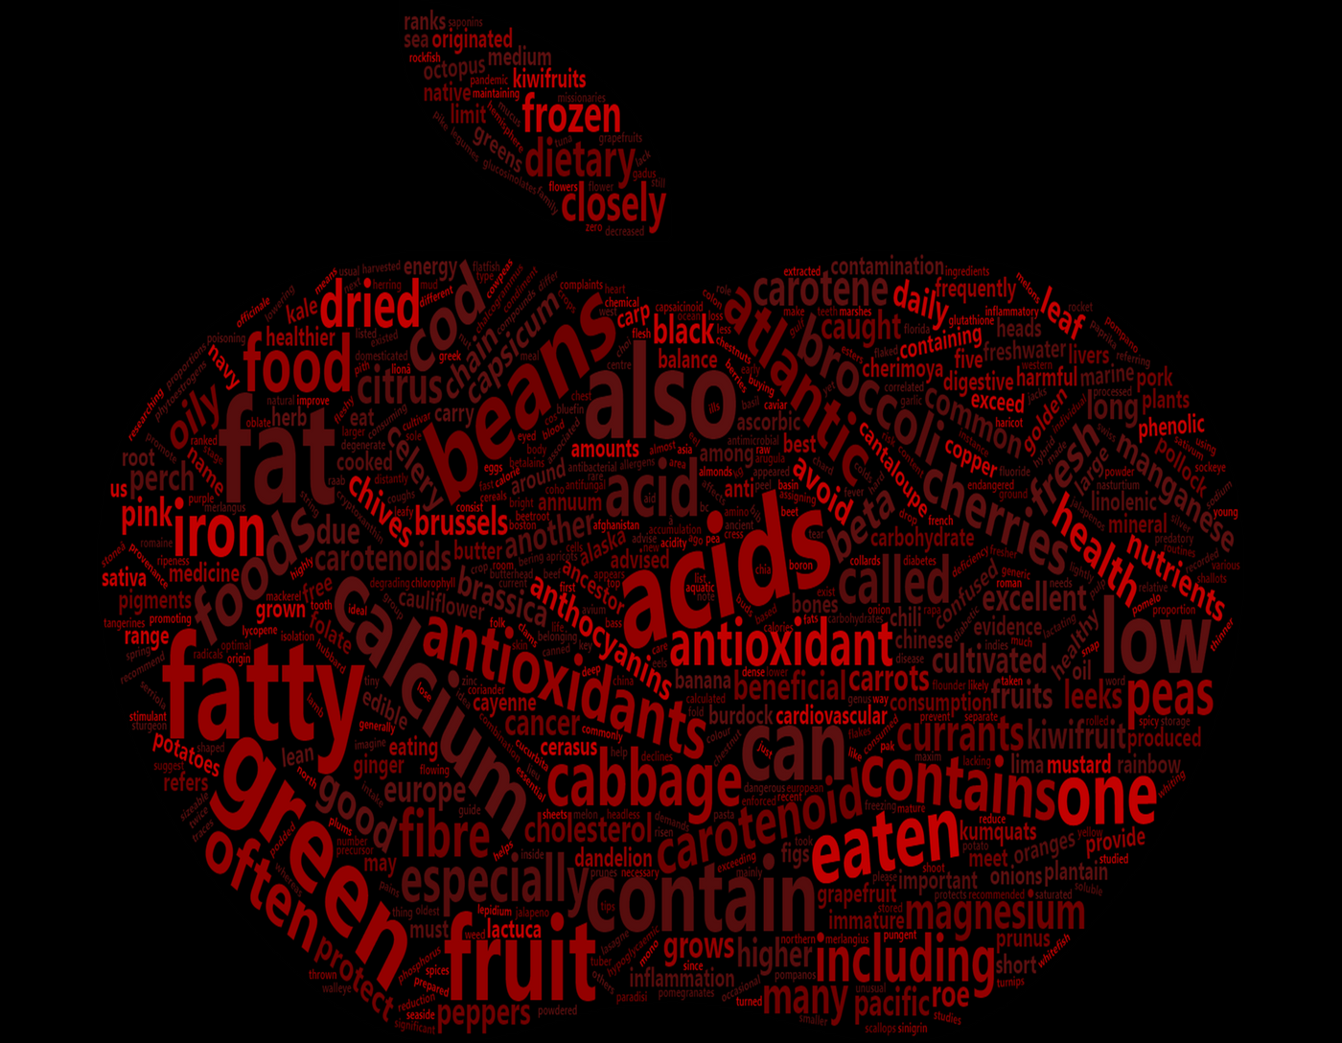

Word Cloud!
https://www.bbc.com/future/article/20180126-the-100-most-nutritious-foods
"An apple a day keeps the doctor away."

Slide 9
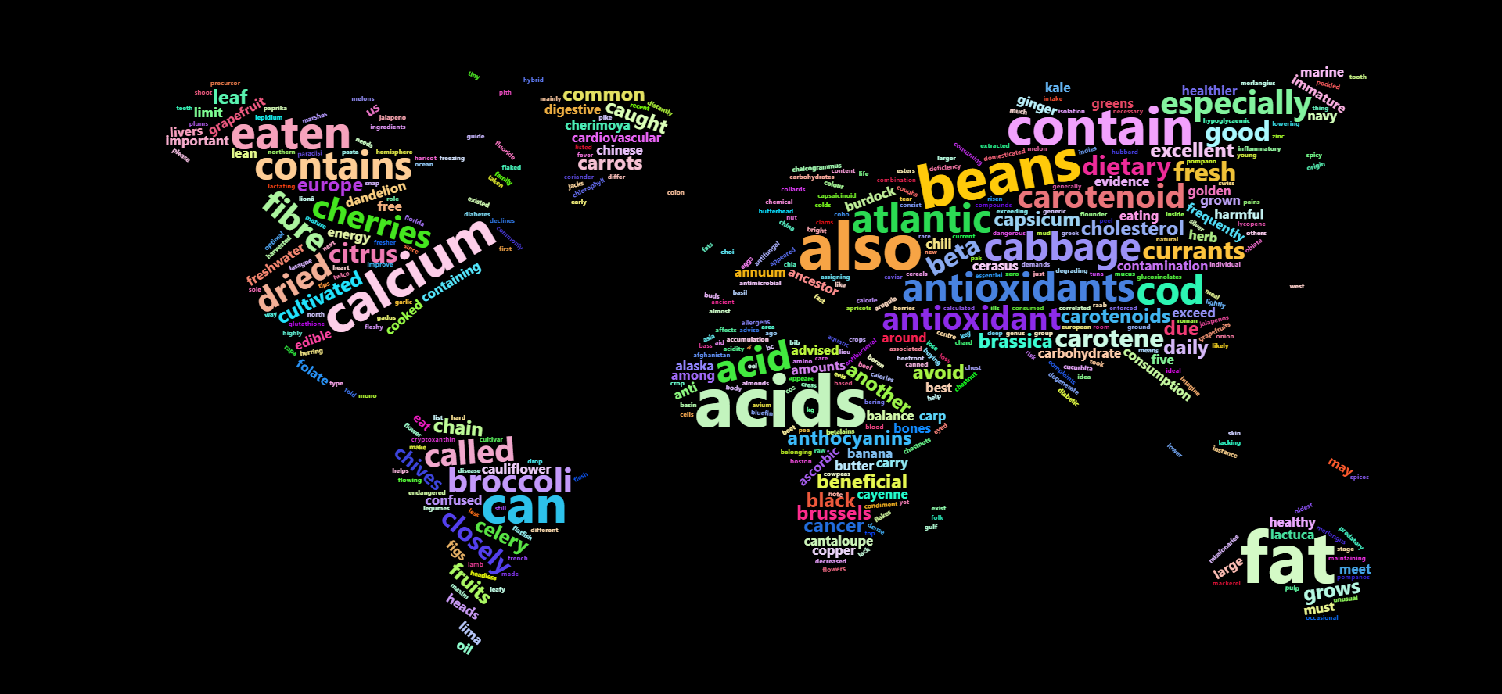
Web scraping was used to extract the text out from a BBC article from their website, directly in R.
The raw data had to be cleaned thoroughly and then finally, the word cloud was plotted based on the frequency of the words.

Slide 10

Thank you!

